Slide 1
The Elastic of Life
Workshop: Competitors – Presentation of results

Slide 2
1. The unmet need
Most therapies delay but do not resolve chronic disorders like aneurysm, emphysema, hypertension, hardening of the arteries, or stroke, and no cure is available.

Slide 3
2. Competitors’ Landscape
Elastic of Life
High efficacy
Surgery
ADD CELL REPROGRAMMING
Pharma competition
Nutrition & Exercise
Physical therapy
High risk
Low risk
Emergency care
Skin care products
Low efficacy

Slide 4
3. USP Matrix ADD CELL REPROGRAMMING
USP | SUGERY | OTHER DRUGS | EXERCISE | NUTRITION | EMERGENCY CARE | SKIN CARE PRODUCTS | PHYSIOTHERAPY | ELASTIC
NON-INVASIVE |  |  |  |  | both | both
SYSTEMIC DECALCIFICATION
RESTORES ELASTICITY |  |  | moderate | ? |  | moderate | moderate
NO NEGATIVE SIDE-EFFECTS |  |  | injury | allergies |  | allergies
NO HOSPITALIZATION
SHORT TREATMENT | depends | (lifelong) |  |  | depends
NO PRECSRIPTION REQUIRED |  |  |  |  |  | depends
NO INFECTION RISK |  |  |  |  |  | depends
PREVENTIVE |  |  |  |  |  | depends
LOW COST |  |  |  |  |  | depends | depends | potentially
NO RESISTENCE RISK |  |  |  |  |  |  |  | To be validated

Slide 5
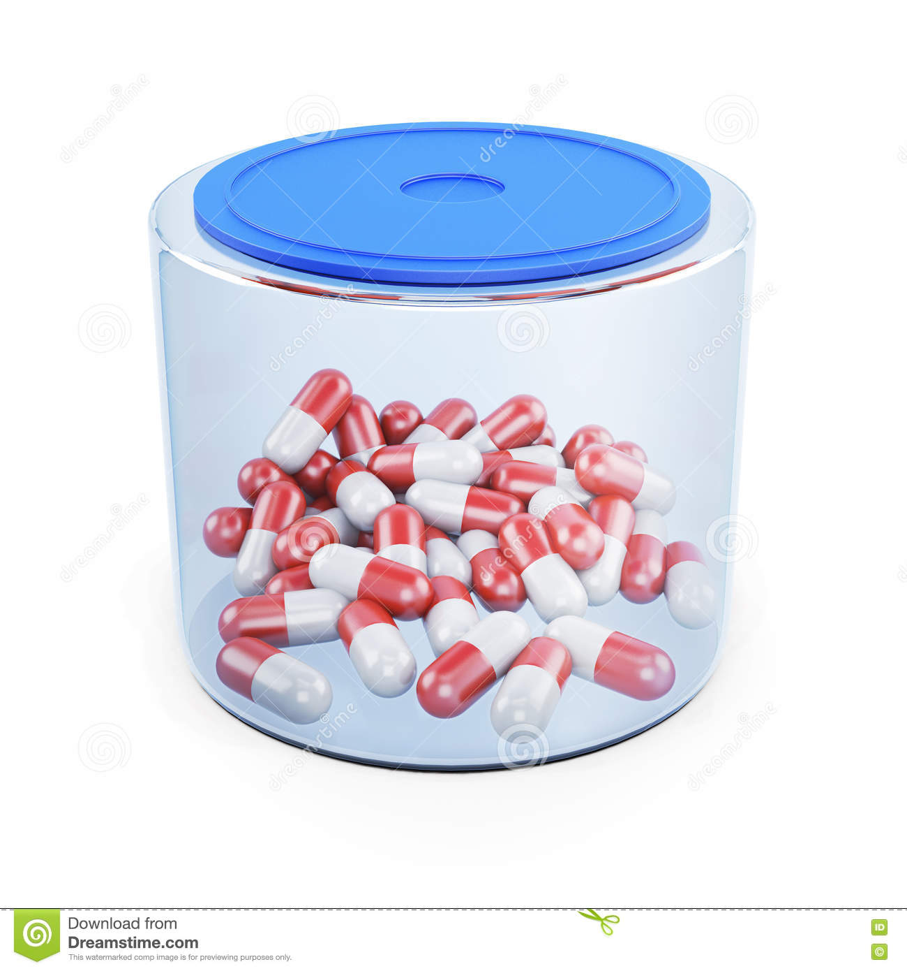
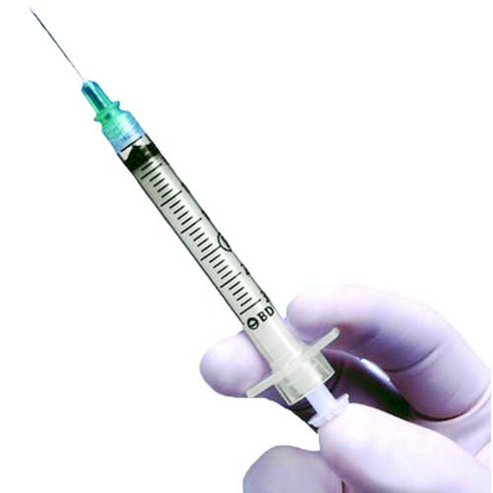
4. Features
Packaging
Delivery Method

